Slide 1
Kentucky Lead Workgroup
Lead Corrosion and Treatment
KWWOA Annual Conference
Northern Kentucky Convention Center
Rengao Song, PhD
Louisville Water Company
April 9, 2018

Slide 2
Kentucky Lead Workgroup
Lead Corrosion and Treatment
Contributing Members
Rengao Song, Louisville Water Company
Bill Robertson, Paducah Water
Justin Sensabaugh, Kentucky American Water
Brad Montgomery, GRW Engineers
Greg Heitzman, BlueWater Kentucky

Slide 3

EPA Guidelines on Corrosion Control
  In March 2016, EPA published “Optimal Corrosion Control Treatment Evaluation Technical Recommendations for Primacy Agencies and Public Water Systems”
  The EPA document provides detailed guidance and information on corrosion control practices, including conducting a Corrosion Control Evaluation and developing a Corrosion Control Plan.
  The report also includes recommendations on working with primacy agencies on approval of Corrosion Control Plans.

Slide 4
Corrosion Basics
  Corrosion: An electrochemical reaction between metal surface and water, resulting in metal release into water
    Reduction @ Cathode: 2e⁻+ 1/2O₂ + H₂O = 2OH⁻
    Oxidation @ Anode: Me = 2e⁻ + Me²⁺
  Complex processes
    Pipe material and plumbing practice
    Water quality factors (pH, DIC, ORP, PO₄³⁻, Cl⁻ & SO₄²⁻ ...)
    Hydraulic conditions
    others

Slide 5
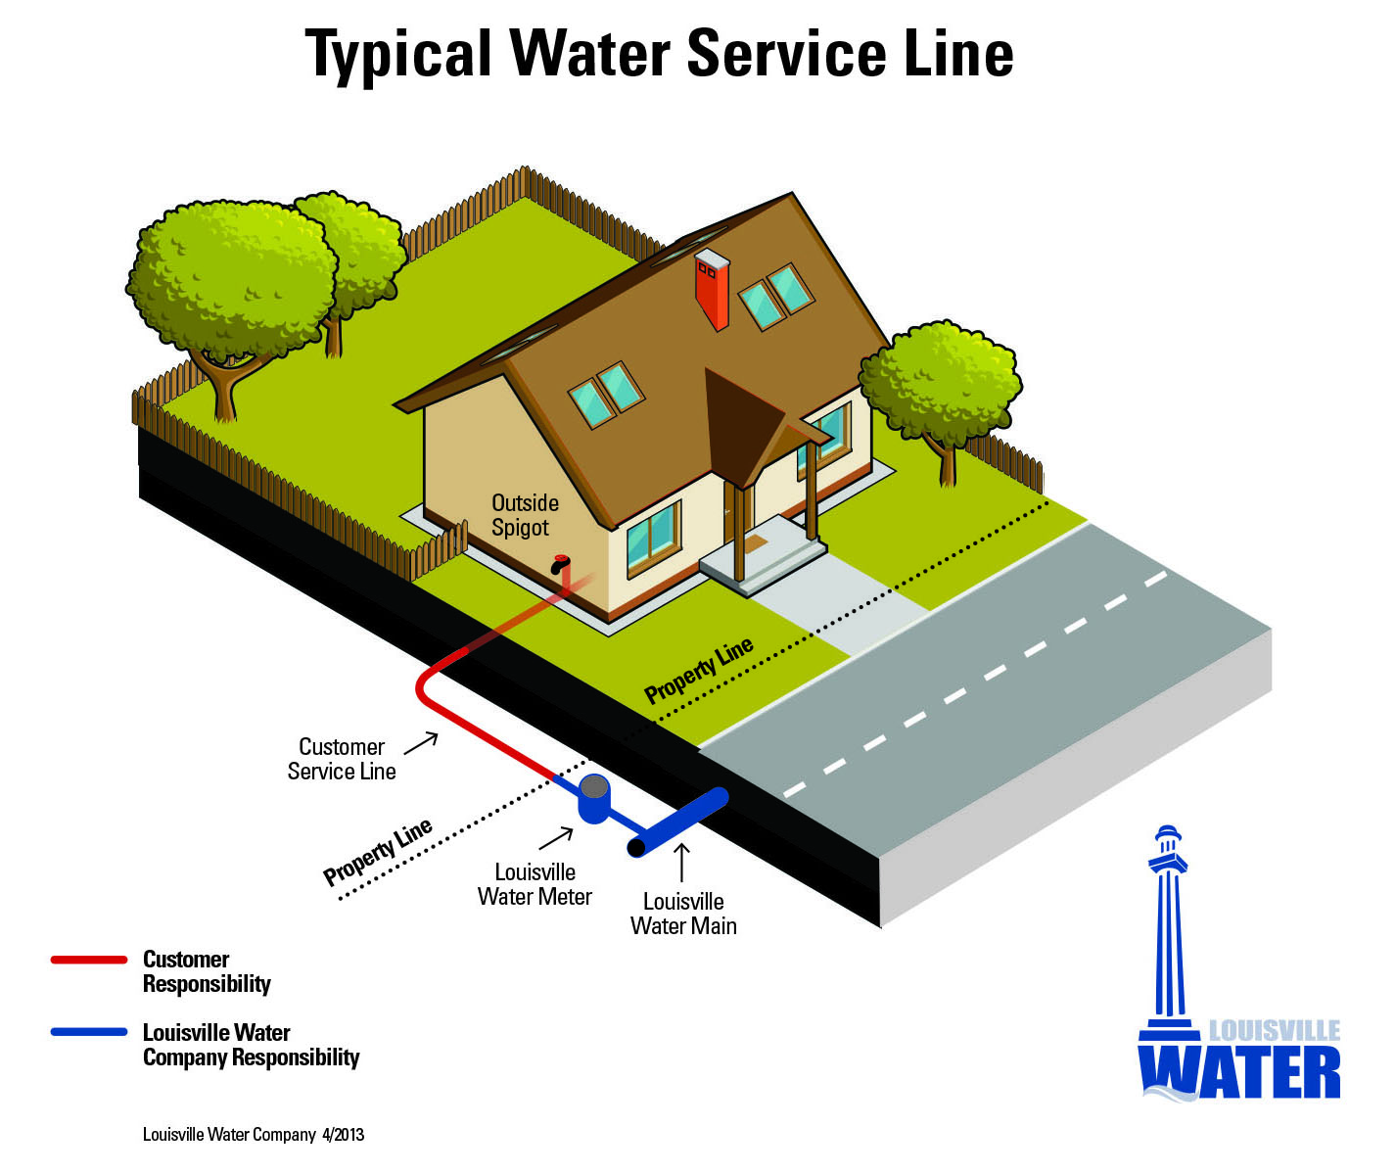
Lead from Service Connections

Slide 6
How to Minimize Lead Corrosion
(plant treatment options)
pH/alkalinity/dissolved inorganic carbon (DIC)
  High pH (≥ 9) and low DIC
Orthophosphate (PO₄)
  Best at pH 7.2 to 7.8
  Issues: Microbial? Wastewater Treatment?
Form insoluble Pb(IV) scale
  High oxidation state, via maintenance of free Cl₂ residual
Cl/SO₄ Ratio
  Higher chloride-to-sulfate mass ratio (CSMR) tends to increase lead release under the conditions of galvanic corrosion
  CSMR<0.5

Slide 7
Orthophosphate Application
Form low-solubility Pb and Cu phosphate complexes on interior pipe surfaces
More effective with low TIC (correlate to Alkalinity) water
Most effective at pH range of 7.2-7.8
Report of potential encouraging nitrification and red water

Slide 8
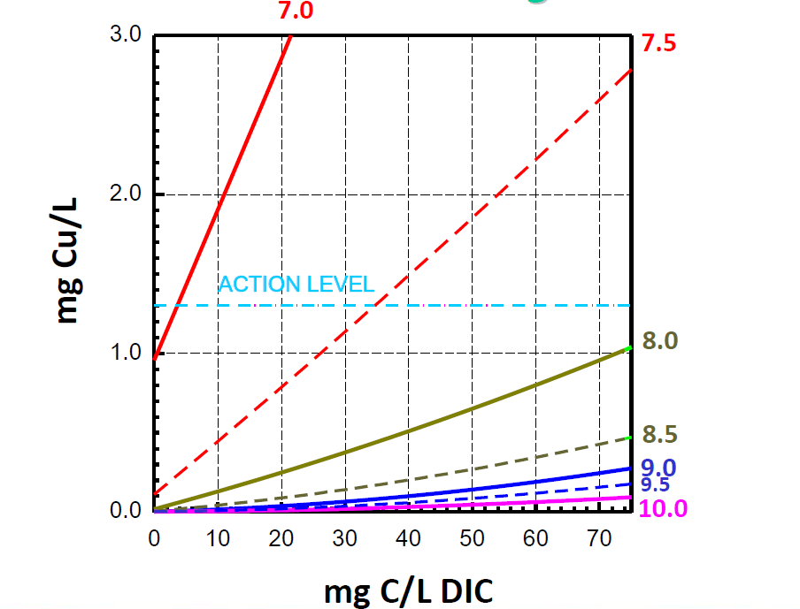
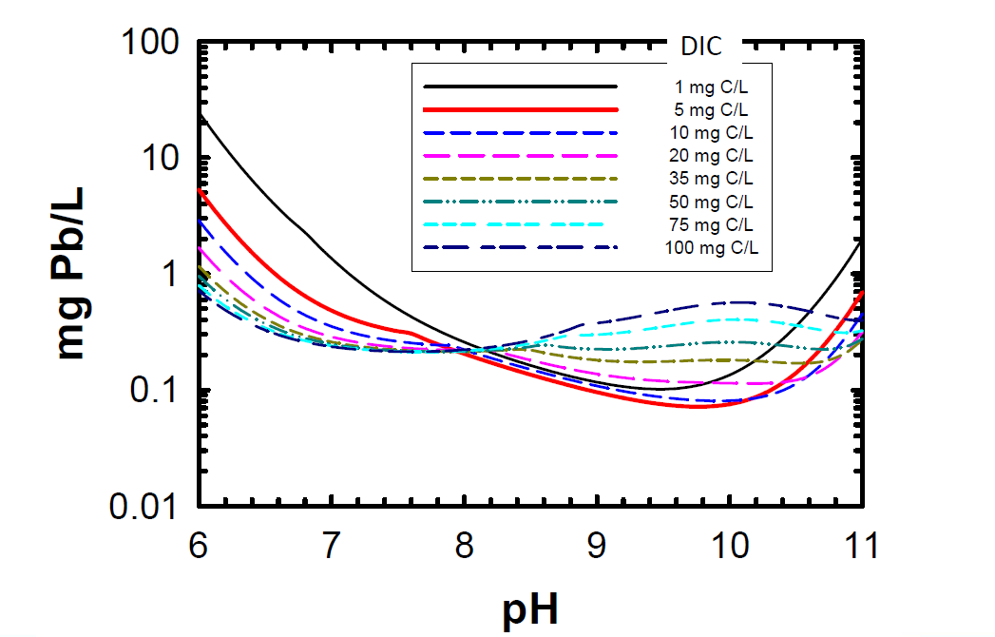
pH Adjustment
Pb and Cu release generally decreases with pH increase from solubility point of view under most conditions
  Raise pH in 0.3 unit increments towards 9-9.5 is recommended as a Pb control strategy if current pH is >7.8 and DIC >5 mg C/L
pH adjustment may not always work when
  pH not high enough throughout DS and need buffering (e.g., water blending, nitrification, CO2 exchange in tanks)
  Dissimilar material on pipe surface or other corrosion mechanisms

Slide 9
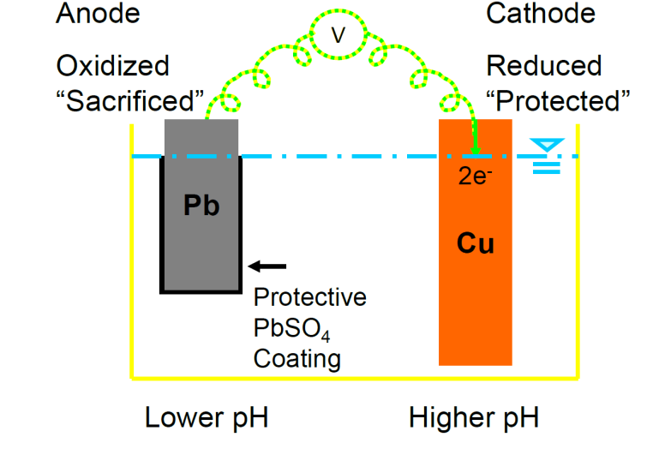
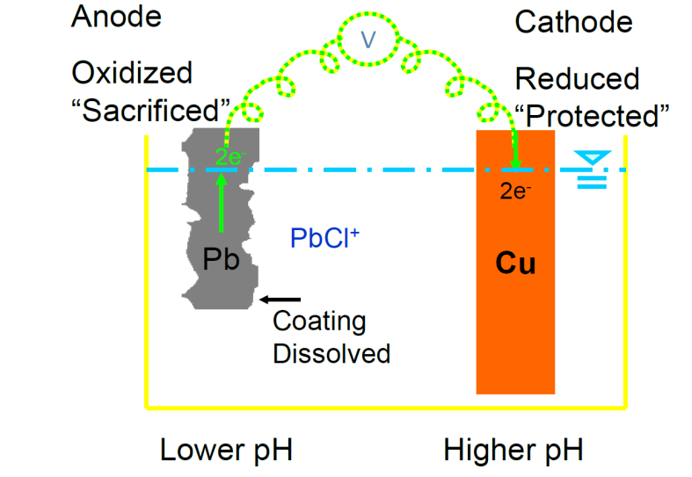
Effect of CSMR
Higher chloride-to-sulfate mass ratio (CSMR) tends to increase lead release under the conditions of galvanic corrosion
A threshold CSMR of 0.5 was reported
  Significant lead leaching may occur when CSMR > 0.5
Sulfate is good: precipitate lead at anode
Chloride is bad: soluble lead complex

Slide 10
Louisville Water’s Research Plan
Water | pH | Collected Location | Coagulant Used | CSMR
1 | 8 | CH finished pH reduced by HNO3 | Full scale (FeCl3) | 0.7-1.0
2 | 8.5 | CH finished | Full scale (FeCl3)
3 | 9 | CH finished pH increased by NaOH | Full scale (FeCl3)
4 | 9.5 | CH finished pH increased by NaOH | Full scale (FeCl3)
5 | 8.5 | Pilot finished | FeCl3 Same Fe dose as CH | 0.6-1.0
6 | 8.5 | Pilot finished | Fe2(SO4)3 Same dose as CH | 0.3-0.4
7 | 9 | Pilot finished | Fe2(SO4)3 Same Fe dose as CH | 0.3-0.4

Slide 11
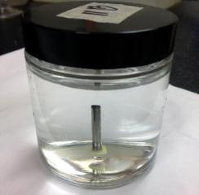
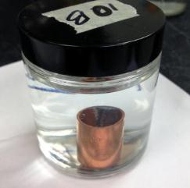
Bench Scale Research Tools
  Non-galvanic solder (NGS) coupon - 50:50 Pb:Sn solder, 1” /1/8” (L/D), epoxied to the bottom of a 120 mL glass jar
  Galvanic solder (GS) coupon -50:50 Pb:Sn solder placed inside copper coupling (right picture)

Slide 12
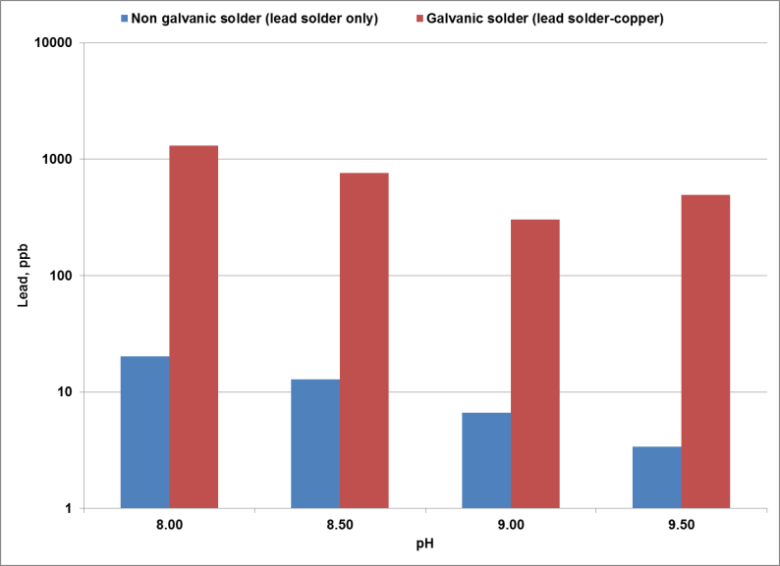
pH Effect on Pb Release
(Data from Louisville Water)

Slide 13
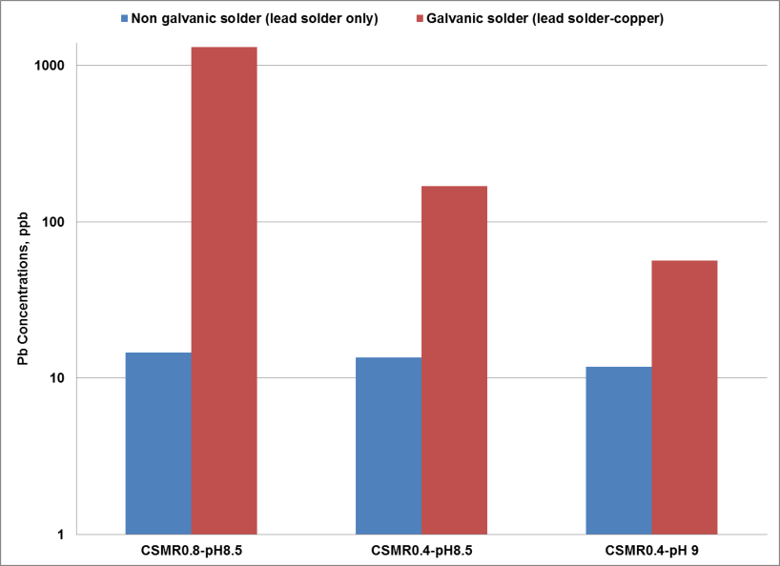
CSMR & pH Effect on Pb Release
(Data from Louisville Water)

Slide 14
Balancing Multiple Regulations
(DBP Example and Utility-dependent)
Optimal range for chloramination (pH 8.0 – 9.0)
Optimal range for PO₄
(pH 7.2 – 7.8)
Optimal range for Alkalinity/pH Adjustment
(pH >9.0)
Historical Iron corrosion control
pH
7.0
8.0
9.0
HAA formation increases
THM formation increases
Difficulty reaching CT increases

Slide 15
Take Home Messages
Leadership and involvement from top management
A WQ team involving key departments across the company
A WQ surveillance team with internal and external customers
Define WQ signal from noise
Review historical data to calculate 90th percentile using only LSL locations
Profile (ten 1L samples) at selected homes
Investigate high velocity flushing after LSL replacement
If close to AL or ~5-8 ppb, look at Pb control alternatives and/or corrosion control enhancement: ready for LTLCR

Slide 16
Take Home Message
Three levels of WQ issues (Result-code)
  System-wide: treatment plant related (water source or and/or source WQ changes, treatment changes/loss of treatment control, unstable water leaving the plant(s)
  Area-wide/Zip code: distribution tanks/reservoirs, major water-main breaks, downstream low demand, nitrification, etc.
  Individual customers: low water use homes may perpetually have high lead; stagnation can affect protective scales within LSLs; LSL disturbances happen daily
Distribution water quality management
  Customers drink tap water not finished water in clear wells
  Water quality can change as it travel from the plant to customer taps: pH drop, nitrification, bio-chemical reactions

Slide 17

Conclusion
Is this noise?
Could it be a signal?
WQ Standards
  Health-based: water is safe to drink
  Aesthetic-based: water is pleasant to drink
  Customer-based: happy to drink
WQ Goal: Delight Your Customers

Slide 18

Rengao Song, PhD
Director of Water Quality and Research
Louisville Water Company
502.569.0880
Rsong@lwcky.com
www.louisvillewater.com

